Slide 1
S5 Weekly Deliverables
By: Azaria Zewdu

Slide 2
Week 1

Slide 3
Introduction
One question I will be trying to find an answer on throughout this entire project is which anime genres have the highest average ratings. As an anime watcher myself this is a question I often think about and wanted to see if theres a correlation to an animes performance being based on the genre aswell. Each genre offers a different type of feel for viewers, which can influence how much people enjoy and rate a show.
Throughout this project I will try to find an answer to this question and use the data available to me to create a data story.

Slide 4
Data Profile
The dataset has 15,000 rows
Column Name | Missing Values | Data Type | Useful | Needs Cleaning
Name | No | Text | Yes | No
Score | No | Numeric | Yes | No
Genres | Yes | Text | Yes | Yes
Type | Yes | Text | Maybe | No
Episodes | Yes | Numeric | Maybe | No
Source | No | Text | No | No
duration | No | Text | No | No
popularity | No | Numeric | yes | No

Slide 5
Data Profile
Column name | Missing Values | Data Type | Useful | Needs Cleaning
members | No | Numeric | Maybe | No
rating | Yes | Numeric | No | Yes
rank | Yes | Numeric | No | No

Slide 6
Curious Questions
Do certain genres consistently have higher ratings than others?
Are niche genres rated higher than popular genres like action?
Do anime with multiple genres have higher average ratings than single-genre anime?
Is there a genre that is very popular but not highly rated?
Are highly rated genres also the most common in the dataset?
Do genres with fewer anime tend to have higher or lower ratings?

Slide 7
Audience
Anime Watchers
discover which genres have the highest ratings and find new anime they are more likely to enjoy
better understand trends in what types of anime are considered high quality
Manga Writers/Anime Producers
Help them find out which genres tend to perform best, helping guide story and genre choices
use audience rating trends to create content that is more likely to succeed and appeal to viewers

Slide 8
Communication Goals
The goal of this project is to identify which anime genres have the highest average ratings and help the audience better understand the story behind the data. This allows anime fans to discover high-quality content and helps manga writers make better decisions about which genres are most successful.

Slide 9
Week 2

Slide 10
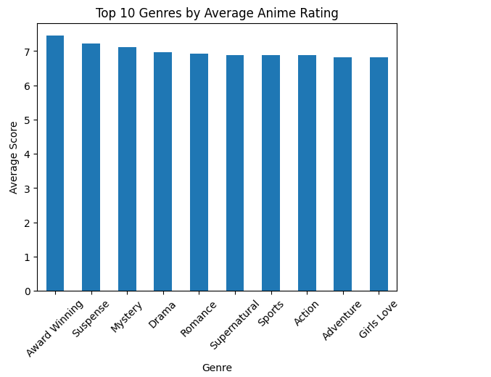
Top Anime Genres by Average Rating
The graph below illustrates the 10 most popular anime genres according to average rating scores. Every bar corresponds to a particular genre while its height is determined by the corresponding rating score.
The graph shows that award-winning anime, suspense, and mystery are usually highly appreciated and scored higher than other anime. Consequently, one may conclude that audiences prefer more sophisticated anime with a compelling story line. Overall, the use of a graph helps me to analyze the performance of anime genres in terms of their rating scores.

Slide 11
Progress
So far, I have been making good progress with my data project by loading, cleaning, and performing initial analysis on the data set using JupyterHub, according to the instructions given, where I am working on processing the genre column, creating a bar chart of the top genres based on the average rating. It has allowed me to start exploring data and observing some patterns in data; however, further analysis of the data needs to be done next week. The most significant problem I had was managing my time since I am taking 19 credits.

Slide 12
Feedback Response

Slide 13
Week 3

Slide 14
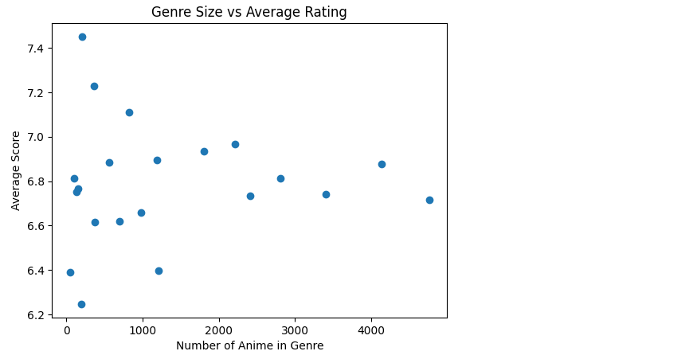
Genre Size vs Average Anime Rating
Each point represents a genre
X-axis shows number of anime in each genre
Y-axis shows average rating for that genre
Helps analyze relationship between popularity and quality
This scatter plot demonstrates the relationship between the number of anime per genre and their ratings. This will help me establish whether popular genres have better ratings. The scatter plot will also help in identifying whether popularity affects the quality of anime or whether smaller genres do better.

Slide 15
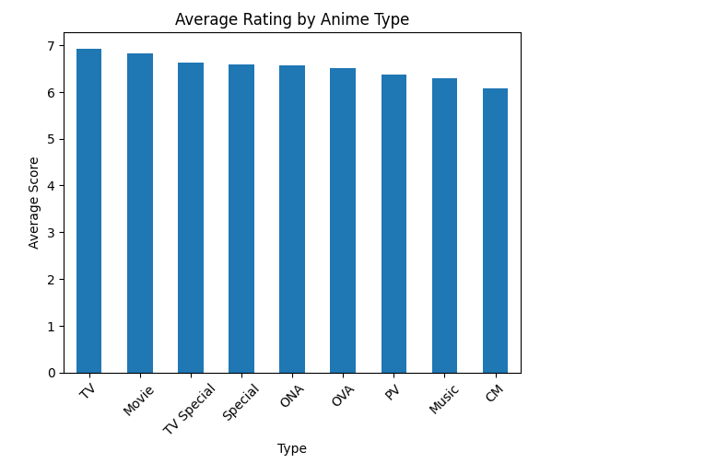
Average Rating by Anime Type
Compares ratings across anime formats
Includes types like TV, Movie, OVA, and Special
Shows how format may impact ratings
Adds another factor beyond genre
The bar graph below shows the comparison between the average ratings of various anime categories such as TV series, movies, and OVAs. This will assist in determining whether particular anime categories are more likely to be rated highly compared to other anime categories.

Slide 16
Progress
So far, I have been able to move forward with my project through the creation of a scatter plot and another bar graph that will aid in analyzing the data. The scatter plot allows for me to identify the relationship between the amount of anime per genre and their average ratings, helping me understand whether the popular genres receive better ratings. With the bar graph that compares the average ratings based on anime format, I can determine how the format may influence ratings

Slide 17
Feedback Response

Slide 18
Week 4

Slide 19
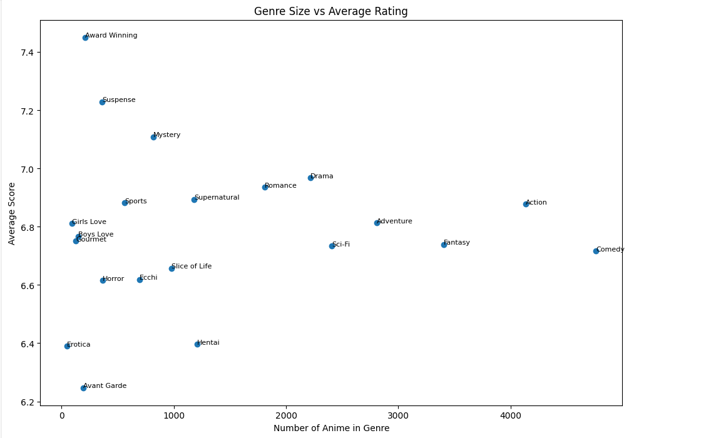
Genre Size vs Average Rating
This scatter plot provides insights on whether the genre of an anime affects its popularity based on the ratio of the size of the genre against the mean score. Every point on the scatter plot corresponds to a specific genre where the number of anime entries within a genre is plotted along the x-axis and the mean score along the y-axis. Through the analysis of the positioning of the points on the graph, one can determine whether genres containing larger numbers of anime entries perform better or vice versa.

Slide 20
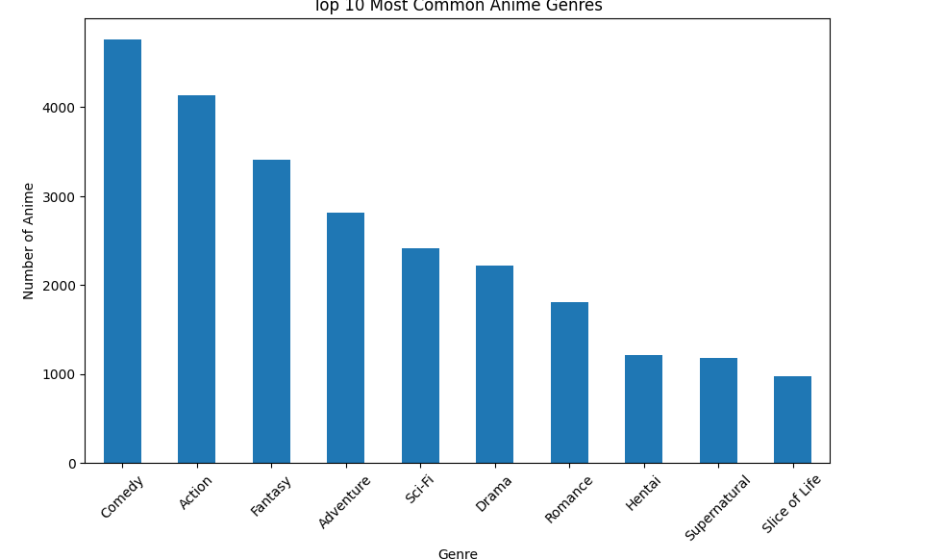
Top 10 Most Common Anime Genres
The bar graph llustrates the 10 best-selling genres that have the largest number of anime series in the data set. Every bar is a representation of a certain genre, whereas the height of each bar illustrates the total number of anime in that specific genre. With the help of this visual representation, one can easily determine the most popular genres in the anime industry and the number of anime produced for them.

Slide 21
Feedback Response
Taking the feedbackinto account from last week, I made several changes that will help improve my project. First of all, I created two extra data points one scatter plot indicating the connection between the size of the genre and its average score, and another one, which is a bar chart listing the 10 most represented anime genres. These two extra data points allowed me to dig deeper into the issue and answer questions that were not covered in my initial inquiry. In addition, I decided to label the names of genres in my graphs.

Slide 22
Progress
I have progressed in my research in terms of cleaning and analyzing the dataset for anime by using JupyterHub and making several different visualizations. Apart from the original bar chart which compares the mean rating of different genres, I created two more visualizations, one was a scatter plot and the other a bar chart. These graphs helped me understand the data. I would say that my future steps will include analysis of the data and then making some meaningful conclusions based on the trends that were observed in the graphs.

Slide 23
Week 5

Slide 24
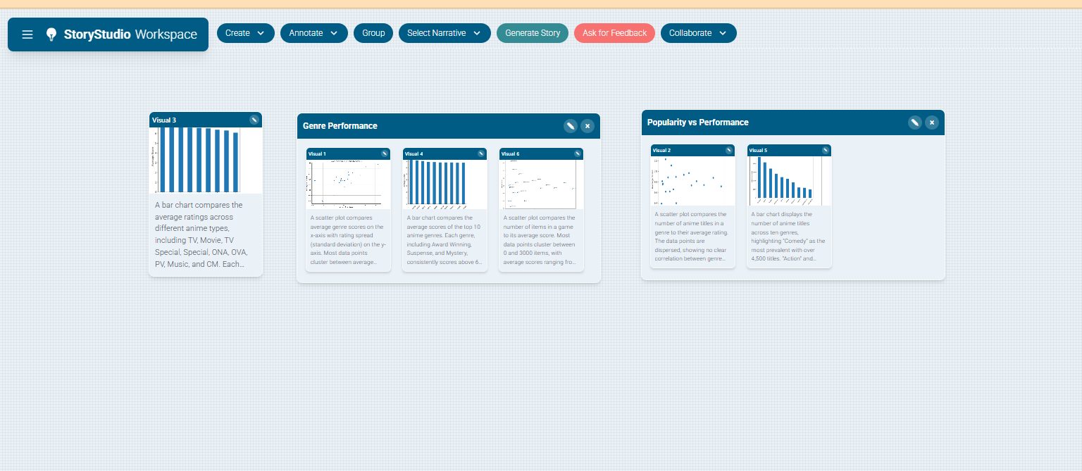
Storyboard

Slide 25
Feedback Response
following the comments I received, I concentrated on increasing the quality of my insights from the data and improving the clarity of my visuals. In addition, I included an enhanced scatter plot showing the relationship between performance and consistency, providing additional insight beyond simple averages., I refined my labeling techniques for clarity and making it more visible. All of these changes have been very helpful in enhancing my analysis. Going forward, I will continue working on my explanations, emphasizing my findings and how they relate to the data.

Slide 26
Progress
This week, I was able to make great progress not just by broadening my analysis but also by structuring my results into a data story. I was able to create a storyboard to structure my visuals into groups, beginning with comparing genres before going deep into their performance. I was able also to craft a micro data story that would help me better communicate how the graphs relate to my research questions. I also crafted several new visualizations such as scatterplots that explore the correlations between genre sizes and the mean ratings as well as their performance versus consistency. This allowed me to shift away from just comparing data and focus more on identifying patterns in the data.

